Slide 1
University Of Diyala
College Of Engineering
Computer Engineering Department
PART II
Combinational Logic Design
Dr. Yasir Amer Abbas
Third stage
2017

Slide 2
Chapter 3
IMPLEMENTING LOGIC FUNCTIONS USING
(MSI) AND PROGRAMMABLE DEVICES

Slide 3
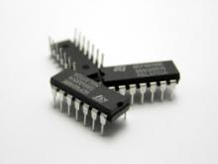
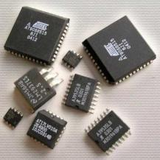
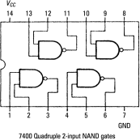
Type of Circuits

Slide 4
Implementation of Logic Circuits

Slide 5
Implementation considerations
What should an engineer consider when selecting a implementation medium?
- Power consumption limits.
Speed performance required.
- Device area\size limits.
- Flexibility\re-use required.
- Domain specific features required
- Financial cost constraints (can depend on sales volume).

Slide 6
Implementation Paths
application-specific
integrated circuit
Integrated Circuits
Flexible Hardware
ASIC
Standard
Fixed Hardware
Fixed hardware
Full-custom
Semi-custom
Processors
SSI/MSI
Gate Array
Custom ASIC
New start
SoC\SiP
Flash
Static
Fuse/
anti
E(E)
PROM
SoC: System on chip
Performance\flexibility trade-off
FPGA
C/PLD
SiP: System in package

Slide 7
Implementation Trade-offs
Provides definite implementation paths for designers with estimated costs and design-times.
Particular devices can provide speed and low-power but without post-fabrication design flexibility.
ASICs (semi) provide flexibility and low power for designs, but with larger financial costs and substantial design-times.
Standard provide lower cost off the shelve computing component and shorter design-times, but possibly providing lower performance and higher power consumption.
Financial cost plays a major role in deciding which path a initial design implementation will follow.

Slide 8
Standard Device Technology
Standard devices are typically off-the-shelve computing components
Provide low cost solutions
Power consumption and performance vary between devices
Devices re-programmed by software, i.e. limited flexibility
Inherently sequential, limited parallelism exploited
Short design time
Several different device technologies available including:
Microprocessor
Microcontroller (Harvard, 8-bit to 64-bit )
DSPs, (32-bit)

Slide 9
Full-custom Technology
Full-custom designs can provide optimal implementations, i.e. lowest power consumption, fastest execution speeds
Expensive due to cost of mask designs and small volume for production.
Designs cannot be altered after fabrication, i.e. no re-programmability or design flexibility
Design times can be substantial up to 18 months
Designs re-spins are often required increasing design time
Example ASIC chip application include digital TV and VoIP

Slide 10
Semi-custom Technology
Semi-custom designs provide sub-optimal implementations, i.e. power consumption can be modest compared to full-custom and execution speeds are lower
Non-expensive compared to full-custom as cost of mask design can be amortized over large volumes for production
Designs can be altered after fabrication, i.e. re-programmed
Design times can be less as standard cell and gate arrays are pre-defined components that can be easily incorporated, 9-12 months
The trade-off of performance to obtain increased flexibility and lower costs has seen the creation of programmable logic

Slide 11
Shannon's Expansion Theorem
T11a:
T11b:

Slide 12
Shannon's Expansion Theorem
Let X1=0 in T11a
Let X1=1 in T11a

Slide 13
Shannon's Expansion Theorem

Slide 14
Example 7-1/p333
Design a circuit using MUX to implement the following function by applying Shannon's Expansion Theorem T11a with respect to A and B
Solution

Slide 15
Analyzing a Multiplexer Design

Slide 16
Programmable Logic Devices
(PLD)

Slide 17
PLD
SPLD
Simple PLD
HPLD
High Capacity PLD
CPLD
Complex PLD
FPGA
Field Programmable Logic Devices
ROM
Read Only Memory
PLA
Programmable logic array
PAL/GAL
programmable array logic

Slide 18
Programmable Logic Devices – programmable technologies
Programmable logic devices are available using several different programmable technologies:
- fuse
- anti-fuse
- volatile
- non-volatile
- switch

Slide 19
Programmable Logic Devices - programmable technologies
Fuse - This is a two-terminal programmable element that is normally a low resistive element and is programmed or "blown" resulting in an open or high impedance.
Anti-fuse - This is a two-terminal element that is normally a high resistive element and is programmed to a low impedance.
Volatile memory – (uses actual memory ) The memory elements lose their contents when power is removed from the device. SRAM-based devices are volatile and require another device to store their configuration program.

Slide 20
Programmable Logic Devices - programmable technologies
Fuse links
Anti-fuse links
Volatile memory – SRAM programmable

Slide 21
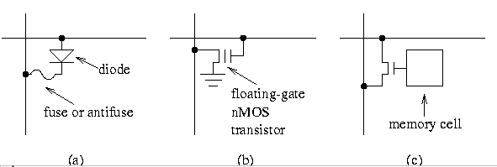
programmable technologies

Slide 22
Programmable Logic Devices - programmable elements
Non-volatile memory - The memory elements keep their contents when power is removed from the device, e.g. Flash, EEPROM, EPROM
- The memory element may be one-time programmable or re-programmable.
- Programmable devices can be both non-volatile and re-programmable.
Switch - This device consists of a memory element (either volatile or non-volatile) which controls a switch. Volatile SRAM-based memory elements are commonly used today.

Slide 23
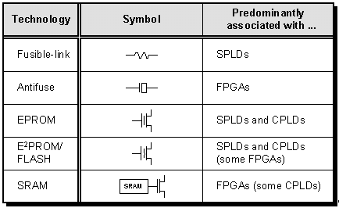
programmable technologies

Slide 24
Classifying Devices
Device can be classed based on their level of programmability
- One Time Programmable: devices can be programmed only once; it's contents can not be changed. While typically these devices are fuse or anti-fuse based, they can also be low-cost EPROM devices.
- Re-programmable: These devices can have their configuration loaded more than once. SRAM-based and Flash-based devices may be reloaded without restriction.

Slide 25
Advantages of using PLDs
less board space.
fewer printed circuit boards.
smaller enclosures.
lower power requirements (i.e., smaller power supplies).
faster and less costly assembly processes.
higher reliability (fewer ICs and circuit connections & easier troubleshooting).
Allow design change (availability of design software).

Slide 26
Programmable Logic Device (PLD’s)
Inputs
Most of these devices are based on a two level structure (sum of products form).
AND
products
OR
plane
plane
outputs

Slide 27
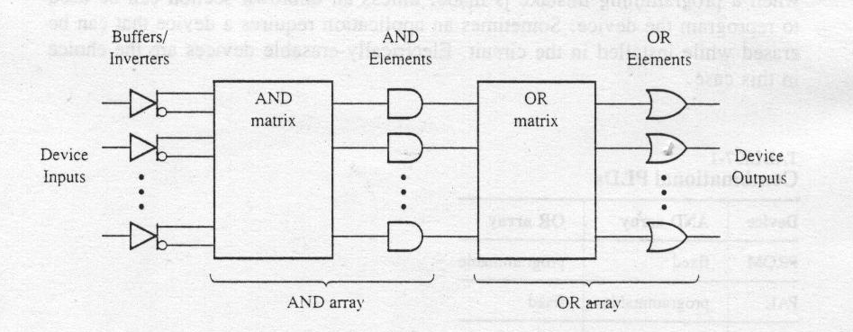
Programmable Logic Devices

Slide 28
Internal Structures of PLD

Slide 29
The main types of PLD include:
PROM’s (programmable read only memory)
PAL’s (programmable array logic)
PLA’s (programmable logic arrays)

Slide 30
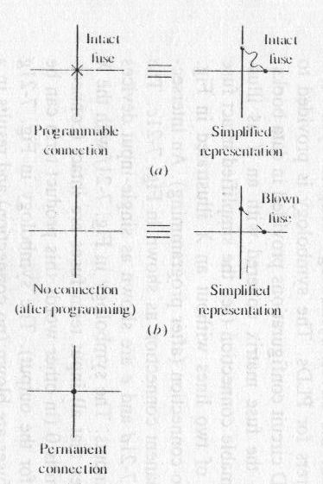
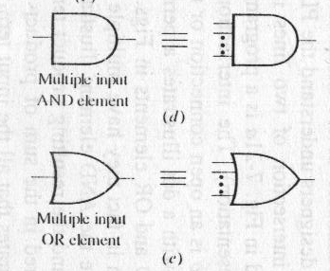
PLD Basics

Slide 31
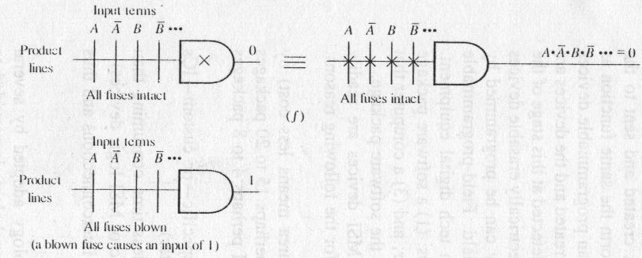
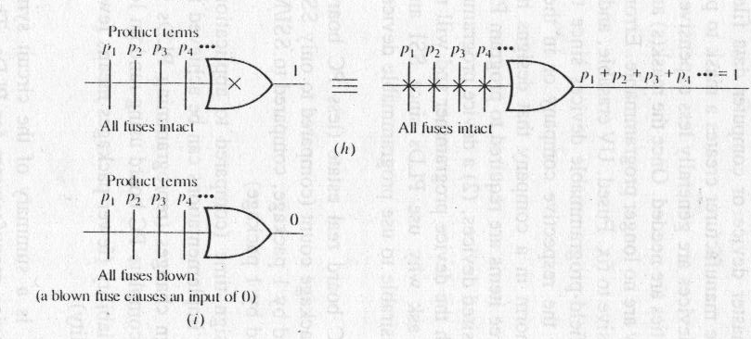

Slide 32
1-Read Only Memory (ROM)

Slide 33
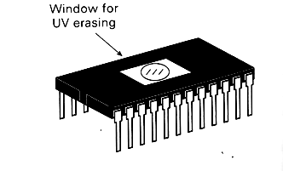
_{Types of ROM}
1. Programmable Read Only Memory (PROM)
Empty of data when manufactured
May be permanently programmed by the user
2. Erasable Programmable Read Only Memory (EPROM)
Can be programmed, erased and reprogrammed
The EPROM chip has a small window on top allowing it to be erased by shining ultra-violet light on it
After reprogramming the window is covered to prevent new contents being erased
Access time is around 45 – 90 nanoseconds

Slide 34
Types of ROM
3. Electrically Erasable Programmable Read Only Memory (EEPROM)
Reprogrammed electrically without using ultraviolet light
Must be removed from the computer and placed in a special machine to do this
Access times between 45 and 200 nanoseconds
4. Flash ROM
Similar to EEPROM
However, can be reprogrammed while still in the computer
Easier to upgrade programs stored in Flash ROM
Used to store programs in devices e.g. modems
Access time is around 45 – 90 nanoseconds
5. ROM cartridges
Commonly used in games machines
Prevents software from being easily copied

Slide 35
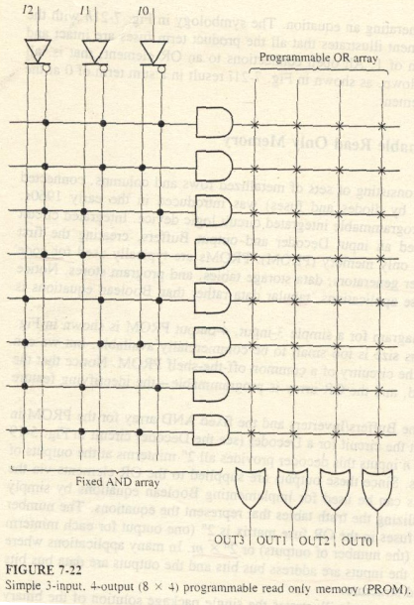
1-PROM

Slide 36
2-Programmable Array Logic (PAL)

Slide 37
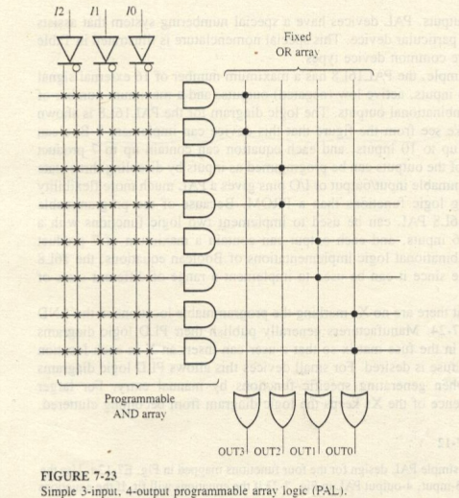
2-Programmable Array Logic (PAL)

Slide 38
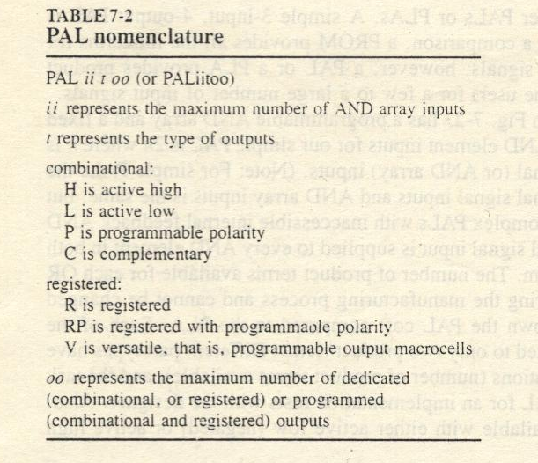
PAL types

Slide 39
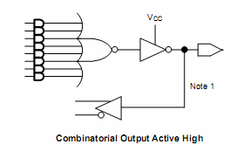
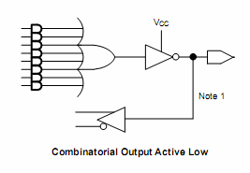
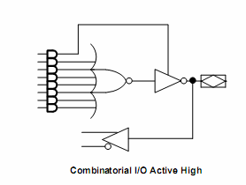
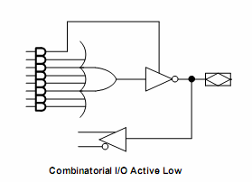
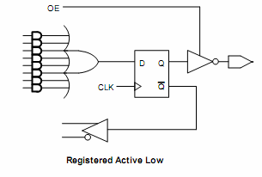
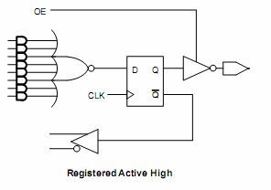
PAL types
High-Output
Low-Output
High-Output/Input
Low-
Output/Input
Register-Low-Output
Register-High-Output

Slide 40
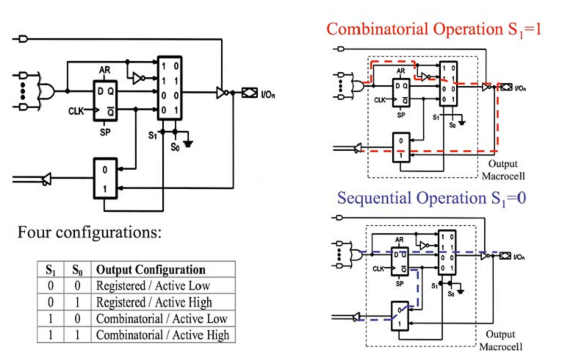
PAL types: versatile

Slide 41
Generic Array Logic (GAL)
GAL is similar to PAL with output logic microcells, which provide more flexibility.
GAL can be erased reprogrammed, Instead of using one-time programmable fuse links, GAL use an EEPROM array.

Slide 42
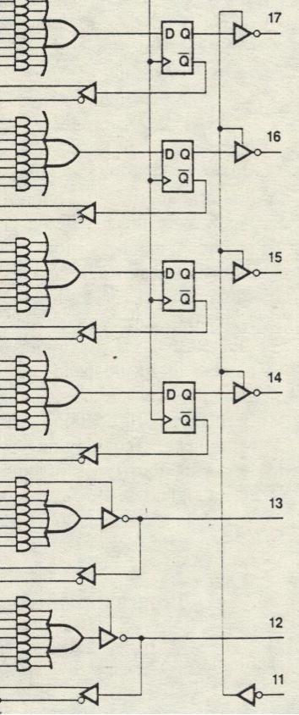
PAL16L4
PAL16R4

Slide 43
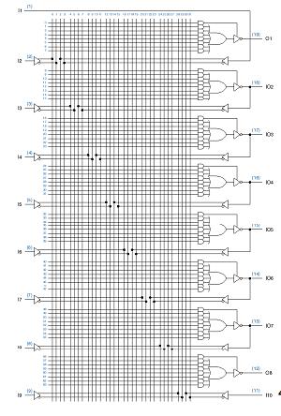
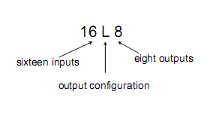
PAL16L8

Slide 44
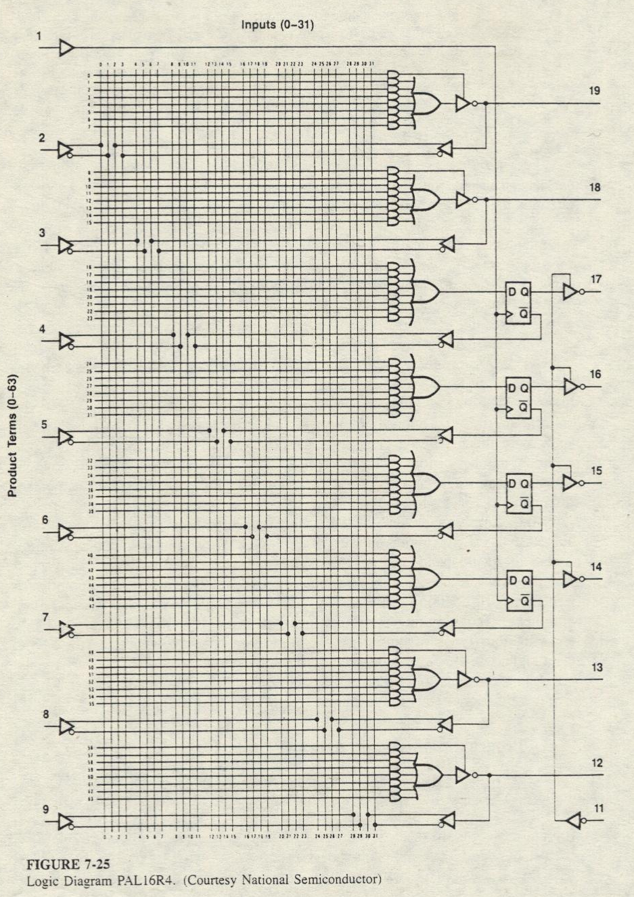
PAL16R4

Slide 45
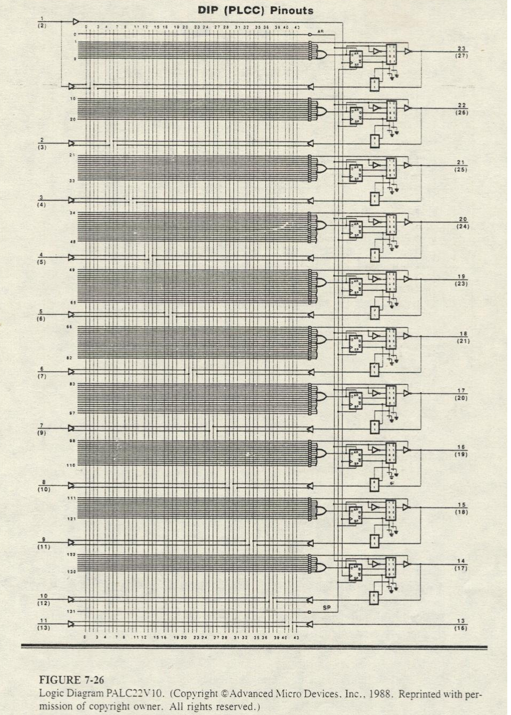
PALC22V10

Slide 46
Exclusive-or-gate with a programmable fuse
(a) Circuit diagram. (b) Symbolic representation.

